Slide 1
Water System Funding Methods
Quantitative Analysis of a Survey for Public Works Directors
17 out of 39 entities surveyed
11 Washington counties · 9 survey questions
An overview of how various Washington public works staff perceive growth, plan infrastructure, and fund expansion
Notes:
Hello, for those of you I haven’t met yet my name is Rowan. Volunteering on behalf of White Salmon City Council, I was tasked with running and analyzing a qualitative survey on how water systems across WA state are funded.

Slide 2
Sample composition
39 entities · 11 counties · 16 useful responses
All towns and PUDs sampled are from the 11 partial-planning GMA counties in WA state.
39 out of 42 towns and county-level entities contacted across Washington (no surveying in Klickitat county to avoid skewing data)
17 surveys (40.5%) yielded useful, codable participation
Two entries are county-level “Public Utilities Districts" rather than incorporated towns
Surveys per county
Attempted surveys per county
WA GMA Public Works Survey | Descriptive Statistics
2 / 11
Notes:
Over the course of a couple weeks, I got 17 useful interviews out of the 39 public works directors & proper members of staff that I called. I asked each of them 9 questions designed to help us better understand their funding situation and level of similarity to White Salmon.
I then combined this information with the most recent population and debt figures available across the board for all 42 of the potential municipalities with a water system. I left Klickitat county out of my surveying population to avoid skewing my data but included them when sourcing population and debt figures for comparison later-on.
Many of the smaller towns lagged behind on reporting their debt and population figures to the state, so I standardized collecting this public data from the year 2024.
Here’s what I found.

Slide 3
Main Findings
SDC use is the most common solution high debt towns utilize for directly funding water infrastructure projects in non-GMA municipalities.
Funding mechanisms used
It’s the most common across the board: 6 out of 17 towns utilize it
An additional 3 towns cited a development charge of some kind as well
When testing its bi-serial ranked correlation with different debt types, it consistently scores high
WA GMA Public Works Survey | Descriptive Statistics
2 / 11
Notes:
System Development Charges are the most common solution high debt towns utilize for directly funding water infrastructure projects in “partial planning” GMA municipalities.
SDCs are also the most common methodology used across the board, with 6 out of 17 towns utilizing them and an additional 3 towns citing the use of an unspecified development charge of some kind.

Slide 4
Definitions
System Development Charge (SDC): A fee levied on a developer to pay for the future cost of water infrastructure expansion, based on water meter size (a proxy for water consumption)
Growth Management Act (GMA): a state law that specifies a multitude of regulations surrounding how local governments can levy fees, including water infrastructure fees
“Partial-planning” (non-GMA) Counties: Counties with a population below 50,000 people. Towns within them abide by different fee levying rules than “full planning” GMA counties
Klickitat County is a “Partial-planning” GMA County
WA GMA Public Works Survey | Descriptive Statistics
2 / 11
Notes:
Now to specify what I mean with some of the necessary terms in those statements…
A System Development Charge, or SDC, is a fee levied on a developer to pay for the future cost of water infrastructure expansion, based on water meter size (as a proxy for water consumption). It’s specifically designed to ensure that towns don’t take on additional debt whenever existing system capacity is reached and expansions are necessary to increase that capacity. The town gains and saves funds proportional to the total capacity taken up in their system and when the time comes to build, they already have the money.
And when I made that distinction before about “Partial planning” GMA Counties, Klickitat county is classified as a “Partial Planning” GMA County, and that’s why I made the distinction.
The Growth Management Act, or GMA, is a state law that specifies a multitude of regulations surrounding how local governments can levy fees, including water infrastructure fees
When Counties are below a population of 50,000 people, they generally fall within the category of a “partial-planning”, or non-GMA, county as opposed to a “full planning” GMA county. Towns like White salmon, located within these “partial planning” counties, must abide by different fee levying rules than “full planning” GMA counties.
Since there are 11 total non-GMA counties in WA State, and 42 total municipalities with a separate water system within those counties, that is what makes up our full sample population. If we were to survey cities in “full planning” GMA counties, they wouldn’t provide useful results because their funding rules are inherently different.

Slide 5
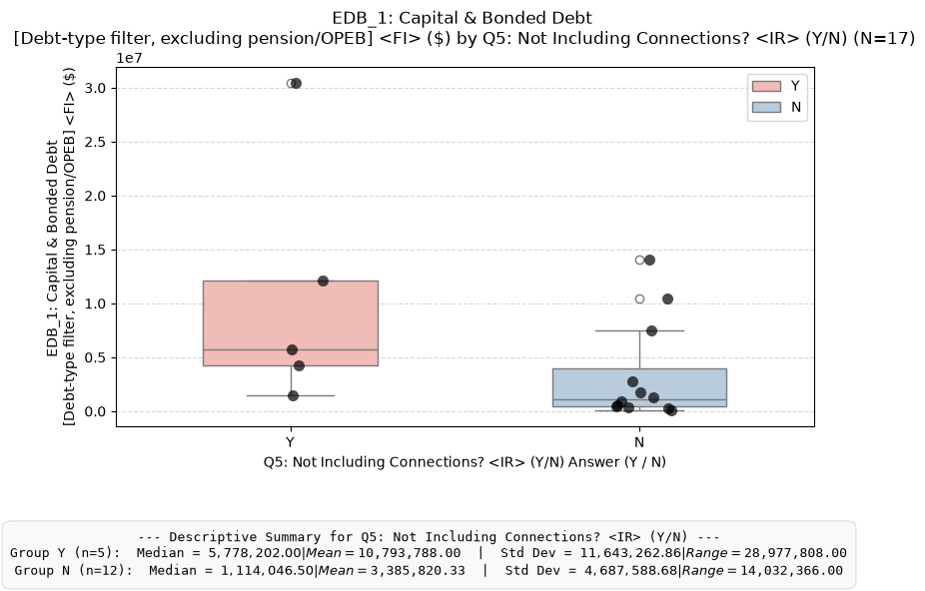
Mann-Whitney U-tests
WA GMA Public Works Survey | Descriptive Statistics
2 / 11
Notes:
The main statistical test I utilized is known as a Mann-Whitney U test.
After completing my interviews with these public works directors, I codified the raw notes I took of their answers into “Yes” or “No” responses for specific sub-questions.
For instance, 5 out of 17 towns had expanded their water infrastructure in some way over the past 10 years that did not include connections, providing me a pool of 5 “Yes” answers and 12 “No” answers.
I can then look at the level of debt each “Yes” town and each “No” town is in and plot those numbers in two separate graphs, one for each response pool. A Mann-Whitney U test grabs all of the towns from each of those two pools then ranks them all by their debt level, followed by a number of other operations to calculate a U-score. The U-score is then representative of the likelihood that a randomly pulled town from the “Yes” pool will have a higher debt level than that of one from the “No” pool.

Slide 6
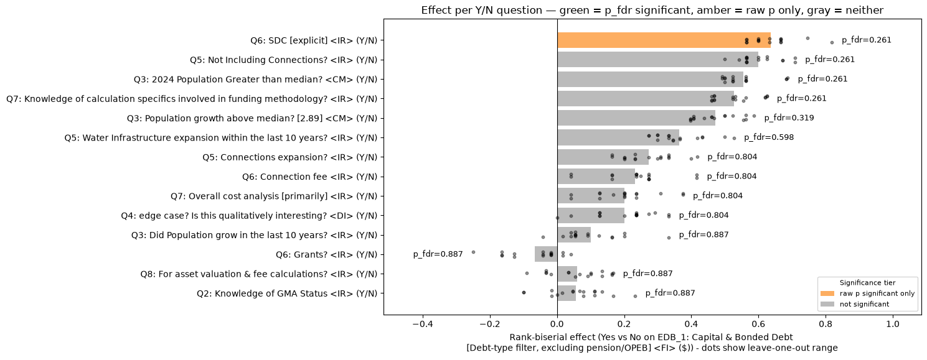
U tests: Capital & Bonded Debt
WA GMA Public Works Survey | Descriptive Statistics
2 / 11
Notes:
Since U-scores change based on the total number of observations, and some questions garnered less useful responses than others, I turned them all into ranked bi-serial effect scores to compare them to one another within the same measurement scale. You can then graph those scores to see how they compare on their association with debt.
Each bar on this graph essentially compares how two distributions differ based on a “Yes” or “No” response, where positive numbers represent “Yes” towns being more associated with high debt and negative numbers represent “No” towns being more associated with high debt. The closer to zero the graph bar is, the less association either response has with debt.
When testing the ranked bi-serial correlation of SDC use with different debt types, “Yes” responses are associated with high town debt for the majority of them.
I tested this across 4 different debt metrics, but this particular one is for Capital & Bonded Debt. Water infrastructure projects are never categorized under pension or OPEB debt charges, so its worth excluding them from the full debt totals per town for accuracy's sake.
Right beneath SDC use on that graph is the metric shown on the previous slide, which is, water infrastructure expansions (not including connections).
The difference in color between the two is due to a difference in statistical significance. SDC use rejects the null hypothesis with a low enough p-value, while the latter does not. Making it the only useful finding that we would not otherwise attribute to randomness.

Slide 7

Correlation doesn’t prove Causation
Skiing may be correlated with snowfall, but skiing does not cause more snow to fall!
SDC use is correlated with high debt towns, it is not indicative of causing debt
Instead, it is fairer to say that towns of high debt tend to find themselves utilizing an SDC to solve that debt
WA GMA Public Works Survey | Descriptive Statistics
2 / 11
Notes:
This might seem obvious, but just because skiing may be correlated with snowfall, does not mean skiing causes more snow to fall!
It may be tempting to say that SDC adoption is associated with high debt, therefore it is causing that debt.
However, there is no way to verifiably prove that with the information we have. Logically speaking, in both cases the reverse scenario is more rational
Snowfall’s correlation with skiing, may prove that more snow causes more skiing if the proper tests are utilized to prove that relationship.
In much the same way that it would make more sense to say that: towns of high debt tend to find themselves utilizing an SDC to solve that debt
The U tests in this case do a better job of proving commonality than causality
--
“Skiing may be correlated with snowfall, but skiing does not cause more snow to fall!”

Slide 8
GIS tool use
Most use overall cost analysis; GIS is widespread but narrow
Q8: 14 of 17 respondents (82%) use a GIS tool
GIS is used almost universally for meter location, but less than 50% of the time for asset valuation
3 towns use a separate tool for their asset valuation
Q8: GIS tool use cases
WA GMA Public Works Survey | Descriptive Statistics
9 / 11
Notes:
Another thing I was tasked with tracking is how GIS tooling is approached by these towns.
I found that most towns utilize a GIS tool of some sorts, specifically 14 out of 17 of them. All except one of these 14 towns use it primarily for keeping track of water main locations and general maintenance, while only 6 towns use it for asset valuation.
There was also no notable correlation between GIS tooling use and debt levels, suggesting a lack of commonality in its use as a facet of debt solution.

Slide 9
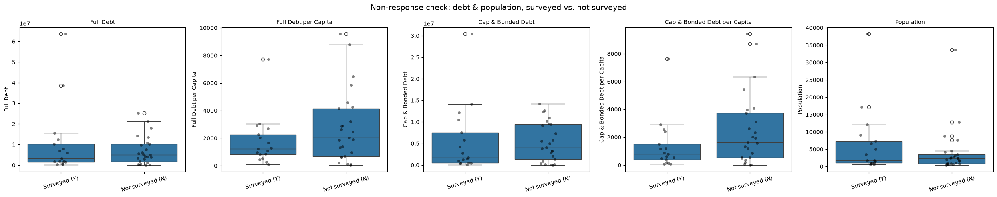
Experimental limitations & Circumstances
17 participants is a relatively low number for stats modeling -> High P values -> possibility of randomness in results
Missing towns have similar population & debt levels -> Having 40% of sample population is substantial -> Minimal “no response” bias
WA GMA Public Works Survey | Descriptive Statistics
2 / 11
Notes:
Its worth noting that 17 participants is a relatively low number of results to fit any sort of statistical modeling to
Our P-values trended high across the board, which means that there is a possibility of randomness affecting our results here
We can however, fairly assume that there would not be a significant difference in results based on the towns that were missing.
We captured 40% of overall sample population & all of the towns I couldn’t get ahold of were at relatively similar levels of debt and population size

Slide 10
Thank You!
Some External Links
A more comprehensive time-series analysis would be necessary to prove true correlation between funding method and effective debt alleviation
This is the GitHub Repo for this project: https://github.com/rowanjmedlock/WS_WaterProj_repo
It contains the formal research report as a Jupyter Notebook
Survey questions, Raw Data collection, A full table for every “Yes”/”No” response, and all 4 of the U-test graphs are included separately as well as within this notebook
Source: WA_GMA_PW_Surveying_Data_Collection.xlsx, 'Full Survey Table' sheet
Notes:
Thank you for taking the time to listen to my presentation!

